Slide 1
ScopedModel
Hansy Schmitt

Slide 2
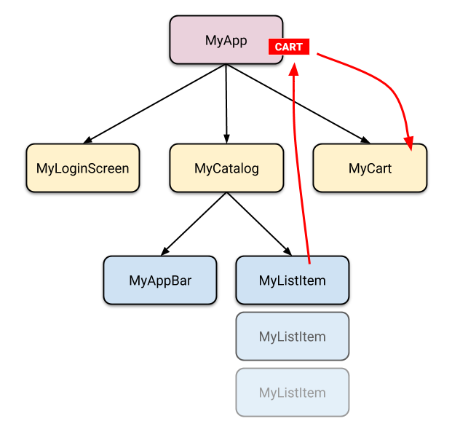
State Management

Slide 3
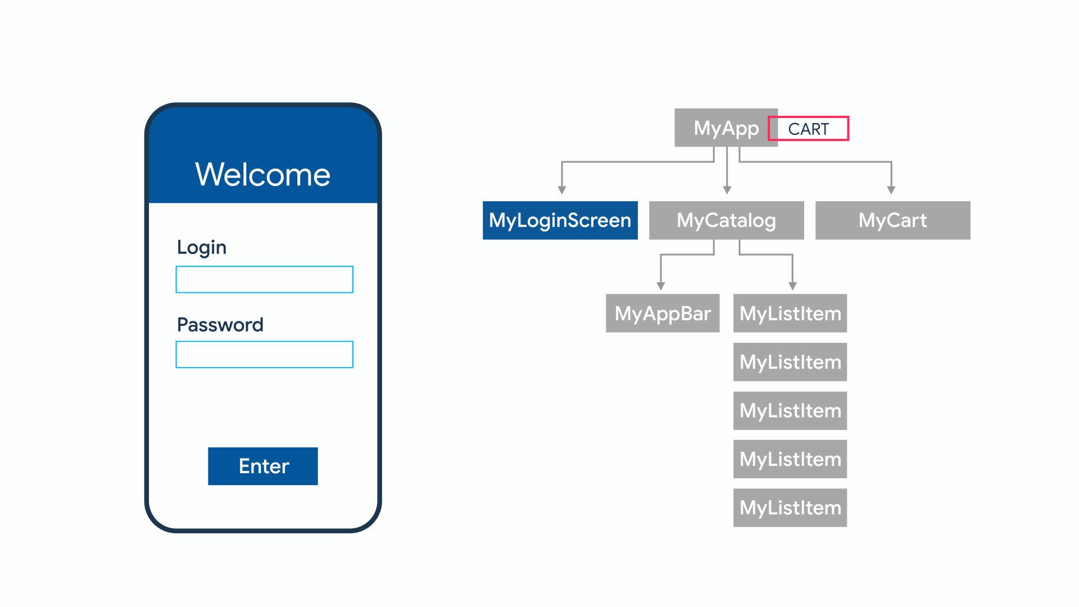
StateManagement
Notes:
https://flutter.dev/docs/development/data-and-backend/state-mgmt/intro

Slide 4
Alternativas
setState
InheritedWidget & InheritedModel
Provider & Scoped Model
Redux
BLoC / Rx
MobX

Slide 5
Redoing the Hello World App
https://pub.dev/packages/scoped_model
Notes:
class CounterModel extends Model {
int _counter = 0;
int get counter => _counter;
void increment() {
// First, increment the counter
_counter++;
// Then notify all the listeners.
notifyListeners();
}
}
// Create our App, which will provide the `CounterModel` to
// all children that require it!
class CounterApp extends StatelessWidget {
@override
Widget build(BuildContext context) {
// First, create a `ScopedModel` widget. This will provide
// the `model` to the children that request it.
return new ScopedModel<CounterModel>(
model: new CounterModel(),
child: new Column(children: [
// Create a ScopedModelDescendant. This widget will get the
// CounterModel from the nearest ScopedModel<CounterModel>.
// It will hand that model to our builder method, and rebuild
// any time the CounterModel changes (i.e. after we
// `notifyListeners` in the Model).
new ScopedModelDescendant<CounterModel>(
builder: (context, child, model) => new Text('${model.counter}'),
),
new Text("Another widget that doesn't depend on the CounterModel")
])
);
}
}

